Slide 1

The Art of Failure
Amy Kapernick
@amys_kapers
#ACSW @ACSWAofficial
Notes:
README: Every slide except the title slide has the 15 second auto-advance timer on it. There are no rules for slide content. You may add your own hashtags and Twitter Account to the footer of each slide, but do not remove the ACS one or the page number. Each slide makes a click noise as it advances as an aural cue. When you hit the final slide you will hear an explosion. You still have 15 seconds on that final slide to conclude. You may do as you wish, but my advice is to not use more than one short sentence on each page, and fill it with a single image. But you may of course use more text and gifs if you want to. 15 seconds is long enough to say 1.5 to 2 sentences depending on how fast you speak.

Slide 2
Why is failure a bad thing?
#ACSW @ACSWAofficial
@amys_kapers 20
Notes:
Failure is an important part of life, and a chance for us to learn. Some of the best things in my life have been the result of failures.
After high school, I moved to Perth to study engineering

Slide 3
5 semesters of Engineering
6 units failed
#ACSW @ACSWAofficial
@amys_kapers 19
Notes:
For my first year, I failed one unit per semester, and then in my second year I failed 2 units per semester. Surprisingly I passed everything in my final semester, but then I finally learnt something very important

Slide 4
I probably shouldn’t be studying Engineering
#ACSW @ACSWAofficial
@amys_kapers 18
Notes:
It took me almost 2 and a half years but I (eventually learnt a lesson from my failures), and because of this I also discovered a job much better suited to me, that I love more than I could possibly imagine

Slide 5
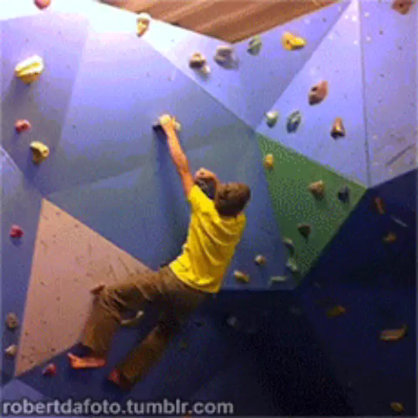
#ACSW @ACSWAofficial
@amys_kapers 17
Notes:
I think that failure is a lot like rock climbing, there are often times when you need to jump for a hold. And sometimes you miss and fall back into the harness and that’s ok. It gives you an opportunity to sit back and take a look at where you were and what happened. You can learn from it

Slide 6
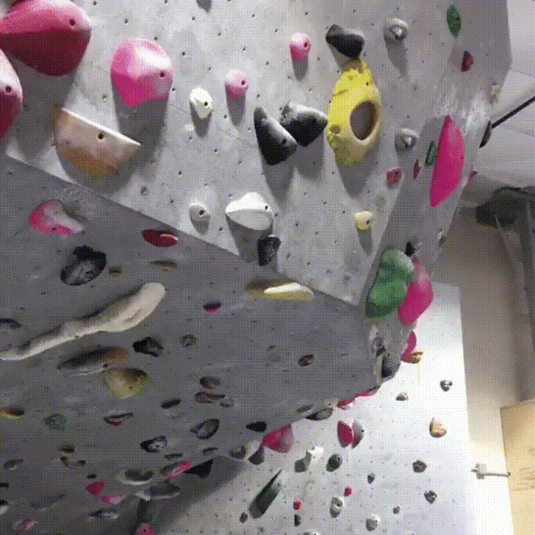
#ACSW @ACSWAofficial
@amys_kapers 16
Notes:
2 years ago I took a huge leap and started working in the web full time, and although there are a few holds I’ve missed along the way, I’m thankful every day that I took the chance and thankful for all the other chances I’ve taken along the way

Slide 7
Failure
#ACSW @ACSWAofficial
@amys_kapers 15
Notes:
Failure, say it to yourself, even the word seems to have negative connotations, it just sounds bad.
We need to change the way we look at failure, the way we address it, the way we use the word failure. Why does it have to be a negative thing?

Slide 8
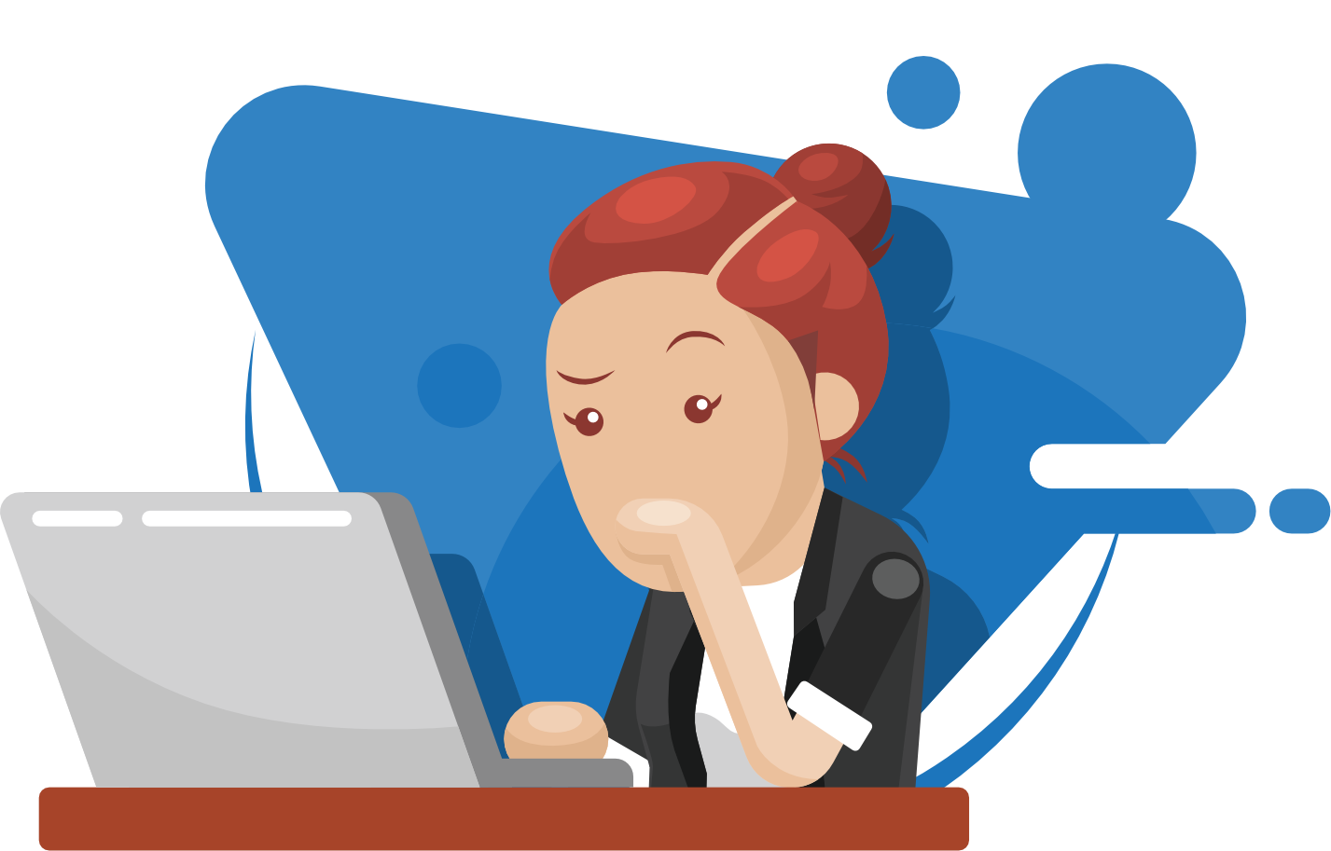
#ACSW @ACSWAofficial
@amys_kapers 14
Notes:
I mean, how often do you really trust success? How many times have you run a test and compiled your code, gotten no errors and completely trusted it?
Recently I migrated a simple Wordpress site from one host to another and it worked perfectly. Except it didn’t, the site worked, but the entire admin console was broken, the migration ended up taking me a week and the site was completely offline for a while.

Slide 9
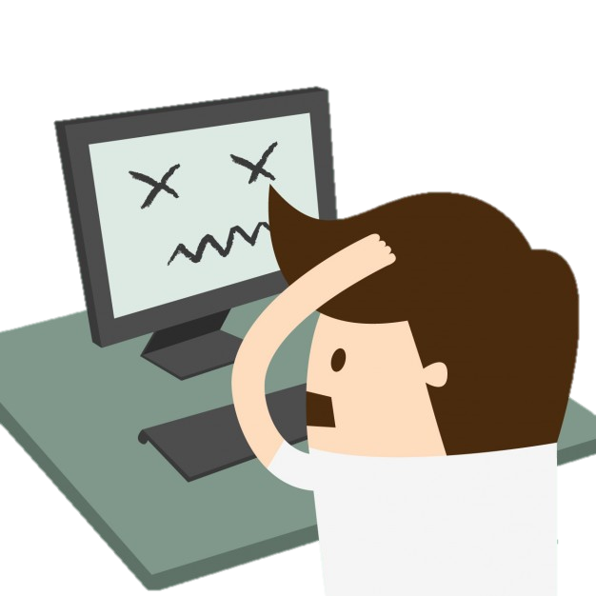
#ACSW @ACSWAofficial
@amys_kapers 13
Notes:
In a previous job I broke the dev server, who else has done that? Well I did that on my second day at my first development job.
Needless to say I was freaking out, it was only my second day but I’d taken an entire server offline.
Thankfully, I found out our team didn’t have failures

Slide 10
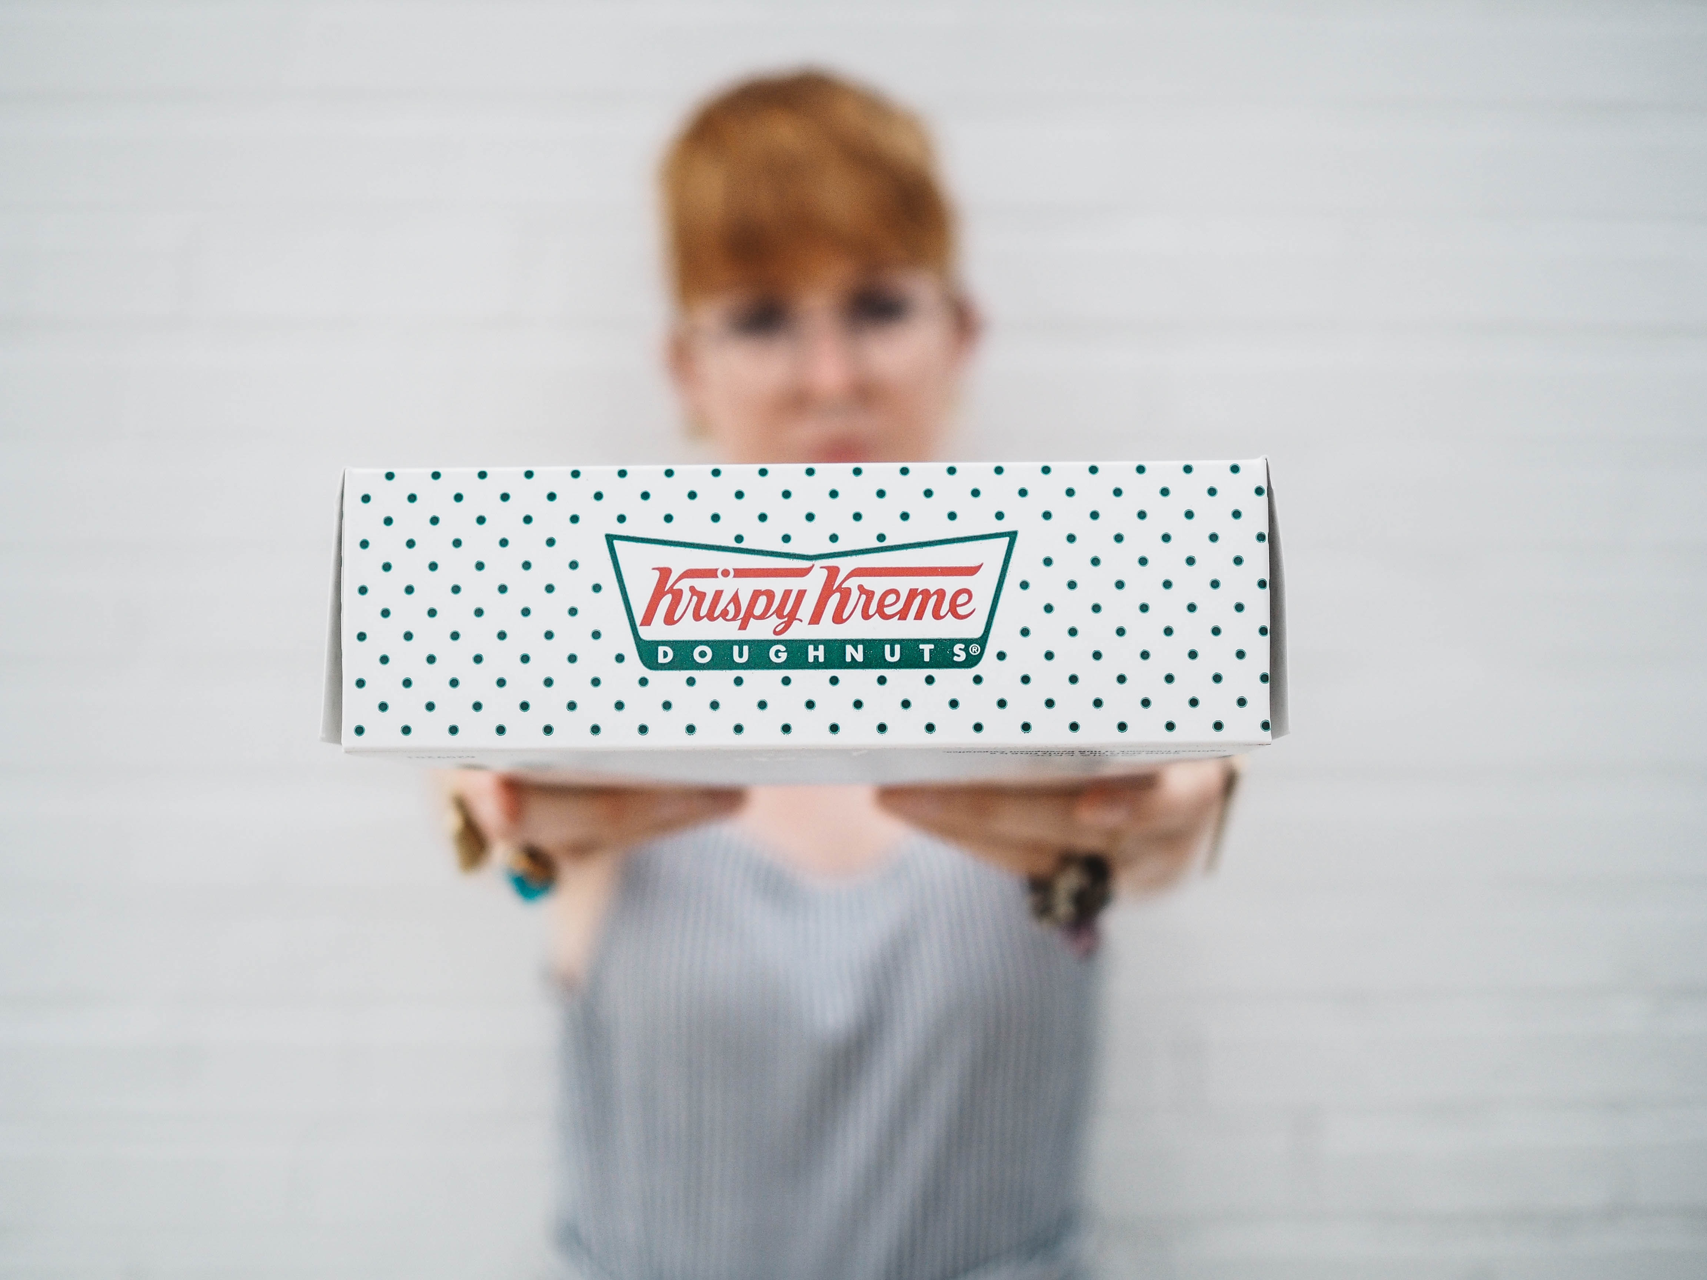
#ACSW @ACSWAofficial
@amys_kapers 12
Notes:
We had doughnuts
If you did something wrong, it was a doughnutable offense
It meant you weren’t afraid of maybe doing the wrong things and you had a chance to learn
There was still a disincentive (have you ever bought Krispy Kremes for 11 people), but you were able to learn and give things a go

Slide 11
Embrace Failure
#ACSW @ACSWAofficial
@amys_kapers 11
Notes:
Failure can be a good thing, and it’s not something we should always avoid
Failure means that we’ve stepped outside our comfort zones and done something new.
If we don’t open ourselves up to failure, we miss the opportunity to try something new

Slide 12
Failure is hard
#ACSW @ACSWAofficial
@amys_kapers 10
Notes:
While we can change the way we look at failure, it still often hurts when it happens.
I’ve faced failures many times, sometimes I jump straight back up the wall but sometimes it shakes you to your core and you don’t want to risk it again.
Thankfully there are a few things you can do to help make it easier.

Slide 13
People
#ACSW @ACSWAofficial
@amys_kapers 9
Notes:
People are important and community important.
In the past few years I’ve gone through many ups and downs, I’ve missed many holds, some personal and some professional.
But through it all I’ve had people by my side
A few years ago I joined Fenders, a group in Perth for Front End Developers, and now I’m a co organiser for it.

Slide 14
Join a Community Group
#ACSW @ACSWAofficial
@amys_kapers 8
Notes:
I would not have made it through the past couple of years if it wasn’t for Fenders and the wonderful people in it.
Perth is blessed with a metric fuck-tonne of community groups and I highly recommend joining one (or all of them)
There’s always someone who’s been through a similar situation to you, and everyone else is there to offer support

Slide 15
Learn
#ACSW @ACSWAofficial
@amys_kapers 7
Notes:
This is something that’s always important in life and across a wide range of industries
This means learning from your mistakes and failures
But this is also important to prepare for failure
I take every opportunity I have to learn something new or to try something different

Slide 16
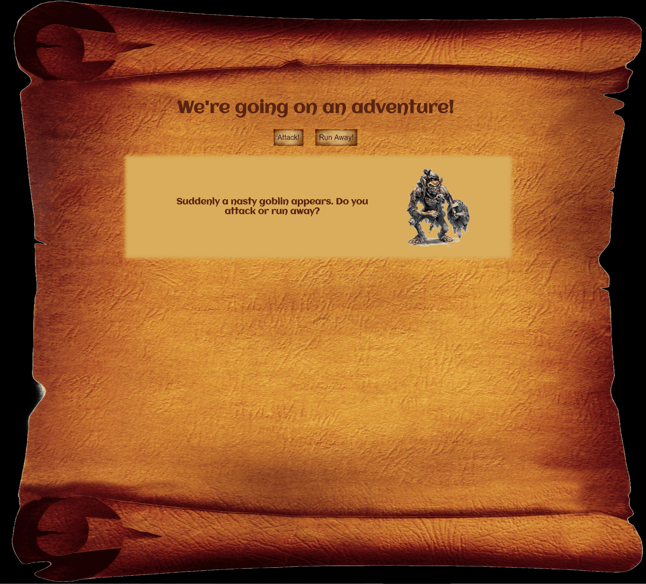
#ACSW @ACSWAofficial
@amys_kapers 6
Notes:
Learning doesn’t just mean reading tutorials or doing something constructive either.
DO SOMETHING FUN!
When I was first looking for roles in the web, I made this game based on our D&D group
It gave me something to add to my showcase and the novelty appealed to several people

Slide 17
You
#ACSW @ACSWAofficial
@amys_kapers 5
Notes:
This is the most important part
Sometimes you have a really important project that needs finishing or just want to put in another hour
I’ve done this before and trust me it doesn’t do well

Slide 18
Take a break - trust me
#ACSW @ACSWAofficial
@amys_kapers 4
Notes:
Make sure you’re looking after yourself first, otherwise you risk the failure hitting you harder
I’ve burnt out before and learned to recognise my own signs and take time out early
It’s ok to take a night off, and give yourself a little selfish time out

Slide 19
Fail - it’s ok
#ACSW @ACSWAofficial
@amys_kapers 3
Notes:
Failure is a fact of life and important for learning
There’s nothing wrong with not getting it right the first time
So take the time to sit back and learn from the experience

Slide 20
Take a leap
#ACSW @ACSWAofficial
@amys_kapers 2
Notes:
And don’t be afraid to jump for it again (but you know, if you just broke dev, maybe don’t do the exact same thing again)
And even more importantly, take the time away from work
Spend time in the community and with friends

Slide 21
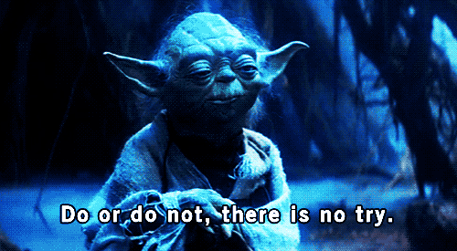
#ACSW @ACSWAofficial
@amys_kapers 1
Notes:
Look after yourself
Don’t be afraid to ask for help or admit you’re not ok
And take a break when you need it
Don’t be afraid of failure, it may become a funny story one day, or at least a funny story

